Slide 2
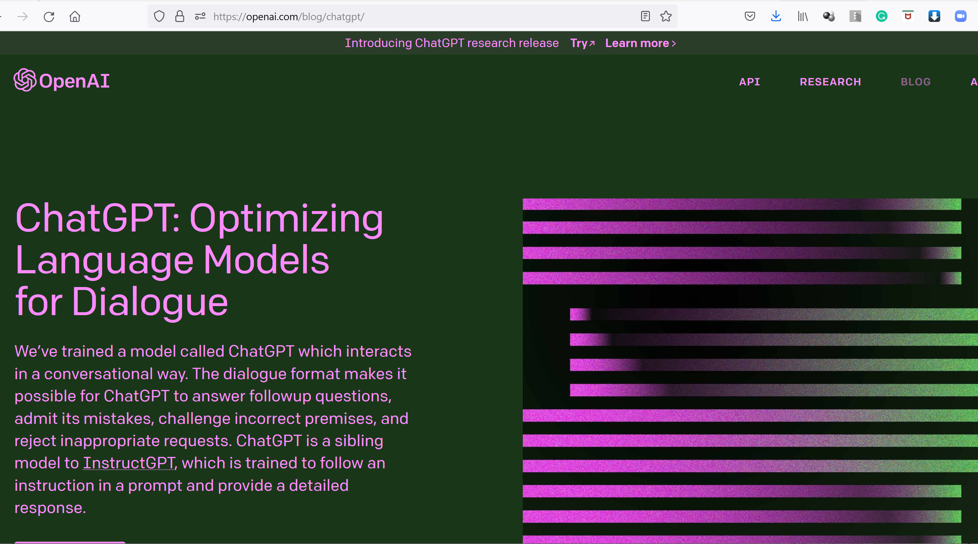
https://openai.com/blog/chatgpt
WHAT IS ChatGPT?

Slide 3
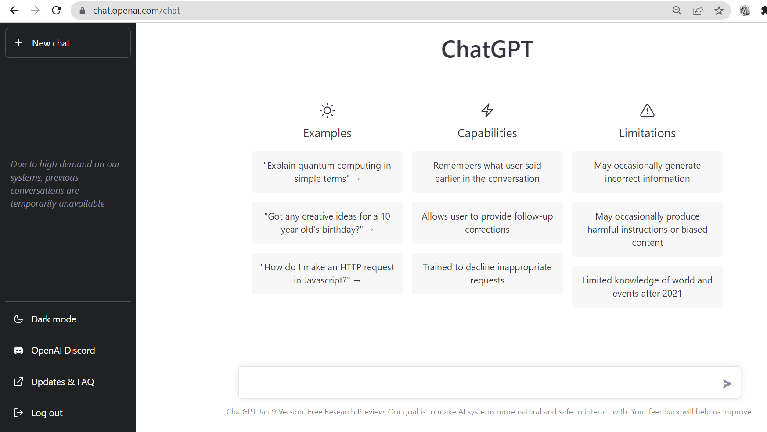
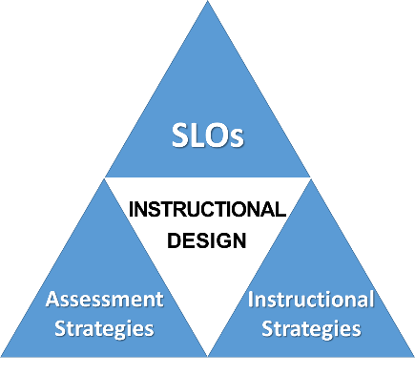
ChatGPT
Answers virtually ANY question on ANY topic
Creates text in virtually any type of format:
Ex: Essays, Reports, Outlines, Spreadsheets, etc.
Limited knowledge after end of 2021
Can sometimes confidently create false info
Bias may exist depending on info sources
- Created by the Center for Teaching and Learning at the American University of Armenia
Notes:
References

Slide 4
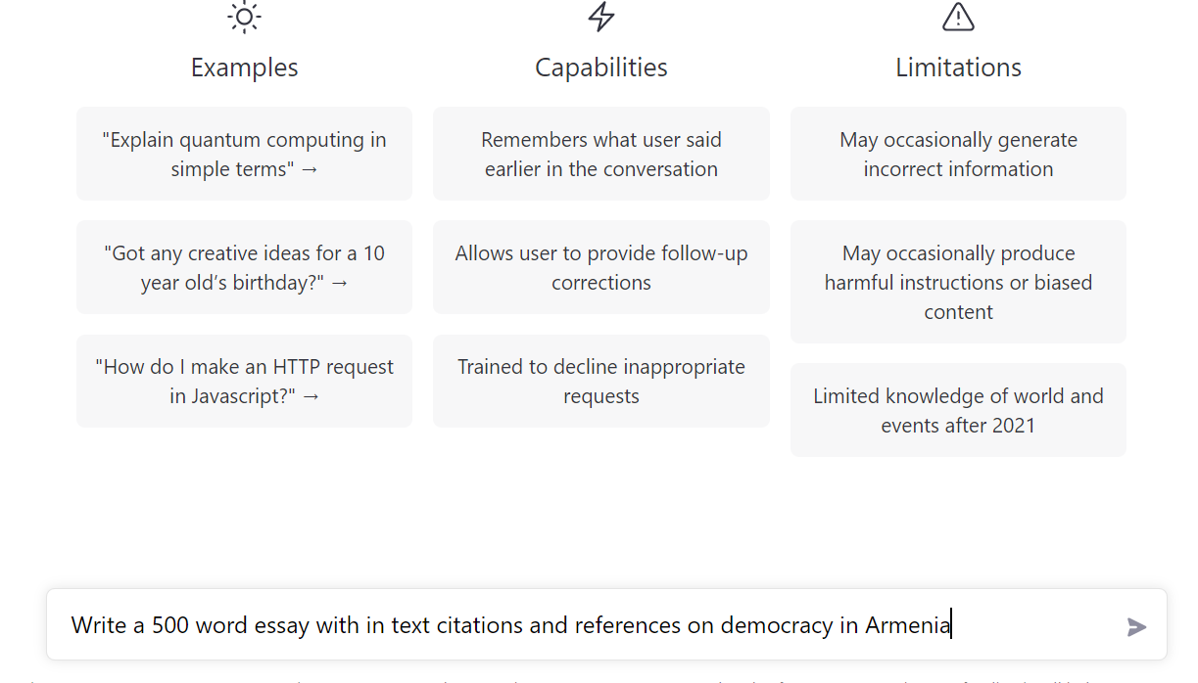
Write a 500 word essay with in-text citations and references on democracy in Armenia
Write a 500 word essay with in-text citations and references on democracy in Armenia

Slide 7
ChatGPT
AI Literacy:
Awareness that AI is all around us
Ability to use it and harness its power
Knowledge that anyone can use it (even students)
Critical Thinking regarding AI Content
Method used to create
Sources used to create
Biases that might exist
- Created by the Center for Teaching and Learning at the American University of Armenia
Created by the Center for Teaching and Learning at the American University of Armenia
Notes:
References

Slide 8
ChatGPT and Education
7-Step Writing Process ChatGPT Integration OR Resistance
Choosing a Topic: Contemplate, research, and reflect, then decide on the appropriate essay topic.
ChatGPT could be used to research potential topics and present options
Brainstorming: Come up with as many good & bad ideas as you can. Review and select the best one.
ChatGPT could be used to help brainstorm ideas by coming up with multiple ideas around a specific subject/idea
Outlining: Structure essay into levels within the intro, body (supporting main idea), & conclusion.
ChatGPT could be used to create an outline based on prompts expressing the main idea(s) (derived from brainstorming) and desired subsections. *Students would verify the logic and desired focus of the writing
Done in class, use specific sources, could require in class info
Could be done in class, answer why, discuss in class
Could be done in class, answer why, discuss in class
Notes:
References

Slide 9
ChatGPT and Education
7-Step Writing Process ChatGPT Integration OR Resistance
4. Drafting: Complete (full sentences, almost perfect) manuscript ready to be reviewed.
ChatGPT could be used to complete a draft from the created outline. *Students would check for completeness, general coherence, and added needed aspects/personalization.
5. Soliciting Feedback: Have someone review your draft and offer suggestions (review the assignment rubric to ensure everything is addressed)
ChatGPT could be used to provide feedback on its own created essay. *Students would verify logic, clarity, and correctness (to include thoroughly checking citations/references)
Discuss, annotated bibliography, answer why, local/current
In-class Peer-Review
Notes:
References

Slide 10
ChatGPT and Education
7-Step Writing Process ChatGPT Integration OR Resistance
6. Revising: Address/fix all feedback issues & continue to strengthen/clarify the essay.
ChatGPT could be used to create a new version of the previously created essay and told to implement noted feedback issues. *Students would verify logic, clarity, correctness, and adherence to rubric.
7. Proofreading: Final review, ensure all is perfect.
ChatGPT could be used to review, proofread, and update content as many times as desired. *Students would verify logic, clarity, and correctness, and adherence to rubric one last time, then submit the final product for assessment.
Discuss in class, annotated bibliography, answer why
Notes:
References

Slide 11
ChatGPT: New, highly advanced, free AI system
(Chatbot/AI-Assistant) developed by OpenAI
ChatGPT freely accessible at:
https://chat.openai.com/chat
Ways to INTEGRATE/USE ChatGPT
7-Step Writing Process
Ways to Make Assignments More Resistant to ChatGPT use
ChatGPT to research potential topics and present options
ChatGPT to help brainstorm ideas around a specific subject/idea
ChatGPT to create an outline *Students verify the logic
ChatGPT creates *Students check for coherence & adds personalization
ChatGPT gives feedback *Students verify, thoroughly checking citations/references
ChatGPT implements feedback *Students verify, checks rubric
ChatGPT used to review *Student submits final version
CHOOSING A TOPIC: Contemplate, research, and reflect, then decide on the appropriate essay topic.
BRAINSTORMING: Come up with as many good & bad ideas as you can. Review and select the best one.
OUTLINING: Structure essay into levels within the intro, body (supporting main idea), & conclusion.
DRAFTING: Complete (full sentences, almost perfect) manuscript ready to be reviewed.
SOLICITING FEEDBACK: Have someone review your draft and offer suggestions (review rubric)
REVISING: Address/fix all feedback issues and continue to strengthen/clarify the essay
PROOFREADING: Final review, ensure all is perfect
Done in class, use specific sources (could include in class info to use)
Done in class, require a mind map / visual representation
Done in class, require specific-personal reasons, class discussion component, answer why
Highly local/post 2021 content, include class discussion (answer why), annotated bibliography
Conduct in-class Peer Evaluations
Discuss in class, annotated bibliography, answer why changes made
Student conducts final review, compares to rubric and submits
Created by the Center for Teaching and Learning at the American University of Armenia
Notes:
References

Slide 12
ChatGPT: New, highly advanced, free AI system
(Chatbot/AI-Assistant) developed by OpenAI
ChatGPT freely accessible at:
https://chat.openai.com/chat
Ways to INTEGRATE/USE ChatGPT
7-Step Writing Process
Ways to Make Assignments More Resistant to ChatGPT use
Specific Sources
In Class Info to Use
Visual Creation Portion
In Class Portions
Class Discussions
Ability to Answer Why
Localization
Modern Info (Post 2021)
Annotated Bibliography
Peer Evaluations
Answer Why Changes Made
ChatGPT to research potential topics and present options
ChatGPT to help brainstorm ideas around a specific subject/idea
ChatGPT to create an outline *Students verify the logic
ChatGPT creates *Students check for coherence & adds personalization
ChatGPT gives feedback *Students verify, thoroughly checking citations/references
ChatGPT implements feedback *Students verify, checks rubric
ChatGPT used to review *Student submits final version
CHOOSING A TOPIC: Contemplate, research, and reflect, then decide on the appropriate essay topic.
BRAINSTORMING: Come up with as many good & bad ideas as you can. Review and select the best one.
OUTLINING: Structure essay into levels within the intro, body (supporting main idea), & conclusion.
DRAFTING: Complete (full sentences, almost perfect) manuscript ready to be reviewed.
SOLICITING FEEDBACK: Have someone review your draft and offer suggestions (review rubric)
REVISING: Address/fix all feedback issues and continue to strengthen/clarify the essay
PROOFREADING: Final review, ensure all is perfect
Done in class, use specific sources (could include in class info to use)
Done in class, require a mind map / visual representation
Done in class, require specific-personal reasons, class discussion component, answer why
Highly local/post 2021 content, include class discussion (answer why), annotated bibliography
Conduct in-class Peer Evaluations
Discuss in class, annotated bibliography, answer why changes made
Student conducts final review, compares to rubric and submits
Created by the Center for Teaching and Learning at the American University of Armenia
Notes:
References

Slide 14
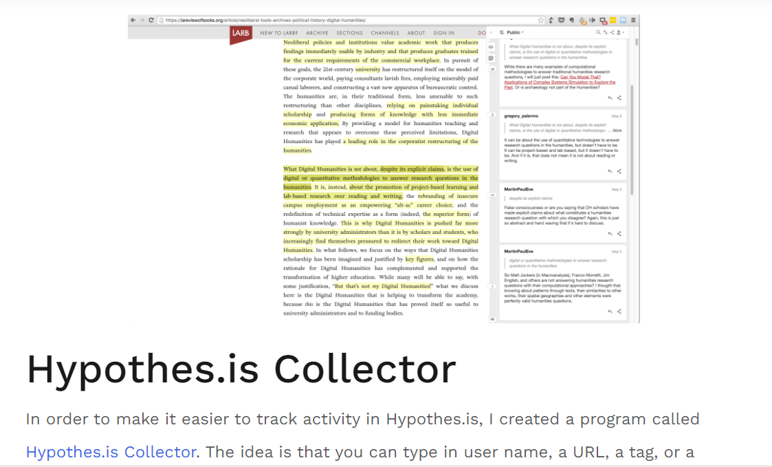
ChatGPT and Assessment
Use some Dynamic Assessment Techniques
Notes:
References

Slide 15
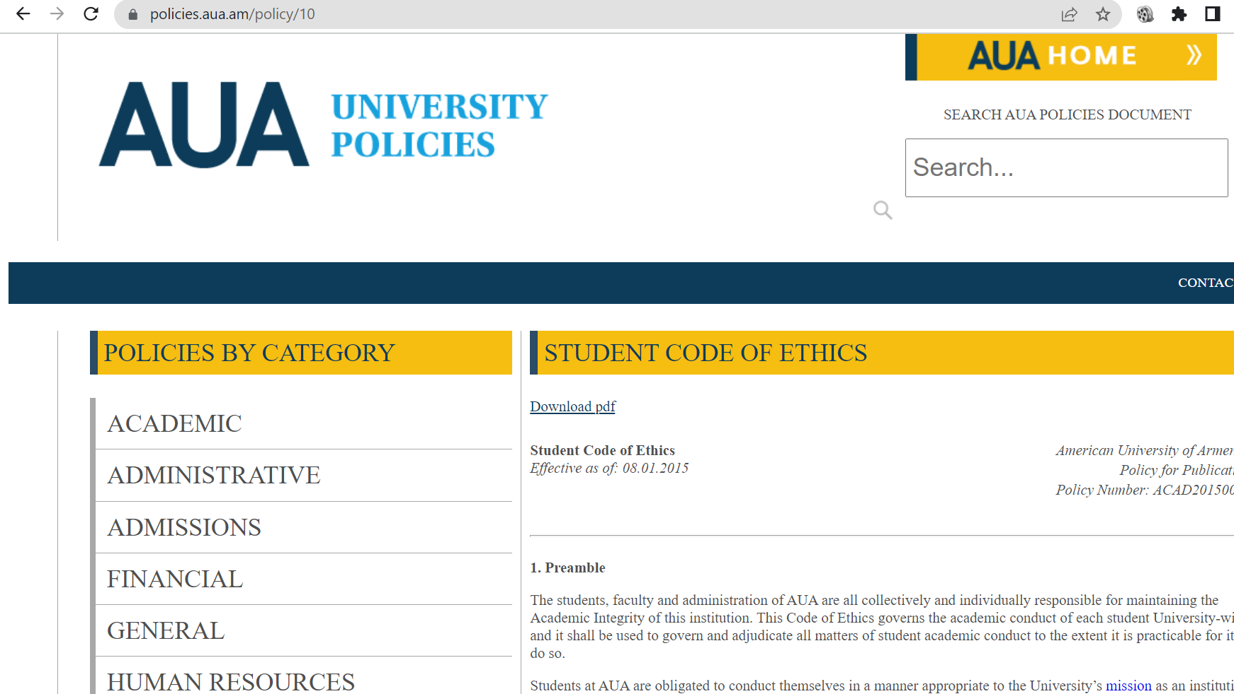

Slide 16
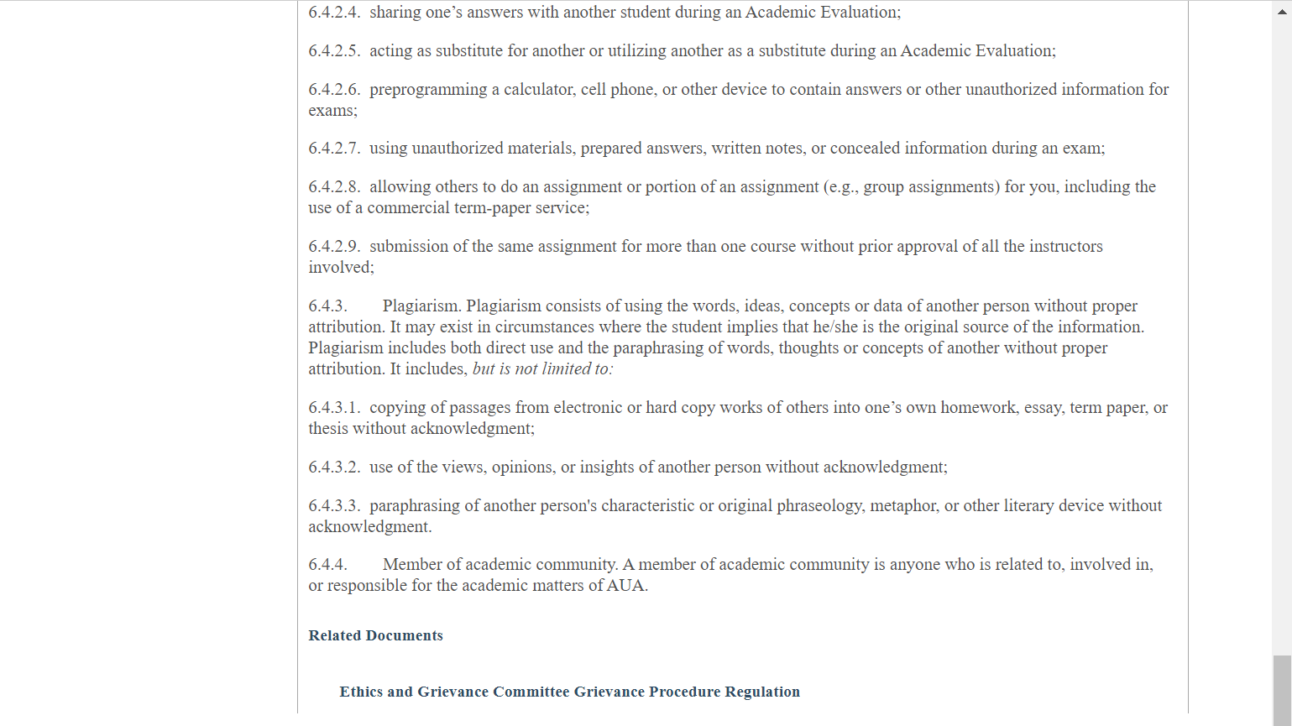
6.4.3. Plagiarism. Plagiarism consists of using the words, ideas, concepts or data of another person without proper attribution. It may exist in circumstances where the student implies that he/she is the original source of the information. Plagiarism includes both direct use and the paraphrasing of words, thoughts or concepts of another without proper attribution.

Slide 17
6.4.2. Cheating. Cheating includes but is not limited to:
6.4.2.1. using or referring to notes, books, devices or other sources of information during an Academic Evaluation when such use has not been expressly allowed by the faculty member who is conducting the examination;
6.4.2.3. unauthorized conferring during an Academic Evaluation

Slide 18
ChatGPT
AI Literacy:
Awareness that AI is all around us
Ability to use it and harness its power
Knowledge that anyone can use it (even students)
Critical Thinking regarding AI Content
Method used to create
Sources used to create
Biases that might exist
- Created by the Center for Teaching and Learning at the American University of Armenia
Created by the Center for Teaching and Learning at the American University of Armenia
Notes:
References

Slide 19
QUESTIONS
About ChatGPT?

