Slide 1
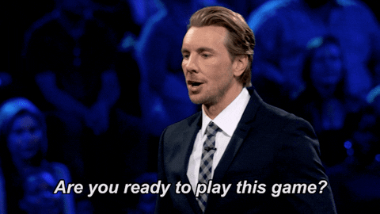
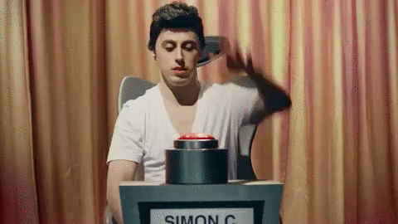
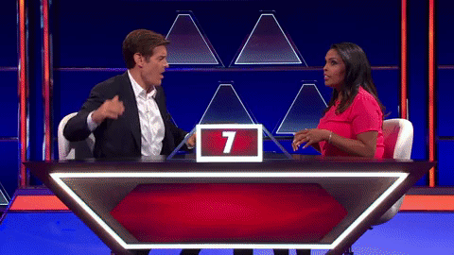
Game Show!
Notes:
Active Learning: Gameshow Developed By: Brent A. Anders, Ph.D. (American University of Armenia) – Free for anyone to use and modify. Make learning engaging, memorable, & fun!
See associated implementation guide to ensure that this instructional methodology is used for the best learning outcome possible.

Slide 2
Why is learning the Narrative Essay important for all majors?
Very Good Overall – make them GREAT!
Some general issues with FLOW
Fully develop your Lesson/Moral
Properly use good details when needed
Notes:
Answer: To be better able describe information and be able to present it to a wider audience. To be able to express in a story format.

Slide 3
Why should you have details in your story?
Very Good Overall – make them GREAT!
Some general issues with FLOW
Fully develop your Lesson/Moral
Properly use good details when needed
Notes:
Answer: To make it more interesting, informative, and to establish a stronger emotional connection.

Slide 4
Is it really wrong to use the word “really” or “very” a lot? Why or why not?
Very Good Overall – make them GREAT!
Some general issues with FLOW
Fully develop your Lesson/Moral
Properly use good details when needed
Notes:
Answer: Yes, it really is wrong. Use more detail instead to make it more interesting.

Slide 5
How could you better express that you were really, really, very hungry?
Very Good Overall – make them GREAT!
Some general issues with FLOW
Fully develop your Lesson/Moral
Properly use good details when needed
Notes:
Answer: Starving | Famished | Drained | use “like” statement or figurative language “I could eat a horse.” (use a better descriptive word or describe the feeling)

Slide 6
How could you better express that you were really, really, very scared?
Very Good Overall – make them GREAT!
Some general issues with FLOW
Fully develop your Lesson/Moral
Properly use good details when needed
Notes:
Answer: Horrified | Terrified | “so scared that I thought I was going to die.” (use a better describe word or descriptive the feeling)

Slide 7
Very Good Overall – make them GREAT!
Some general issues with FLOW
Fully develop your Lesson/Moral
Properly use good details when needed
What is the Hemmingway trap?
Notes:
Answer: Over using details to the point of distraction from the story.

Slide 8
Express a memorable detail from the Take a Walk with Me story.
Very Good Overall – make them GREAT!
Some general issues with FLOW
Fully develop your Lesson/Moral
Properly use good details when needed
Notes:
Answer: Any detail will work as long as it is described in detail (examples: seeing salt lines on soldier’s backs from sweating so much, hallucinating and seeing high school girlfriend, pain shot up like a bolt of lightning).

Slide 9
Very Good Overall – make them GREAT!
Some general issues with FLOW
Fully develop your Lesson/Moral
Properly use good details when needed
Daily Double Image and Sound Credit: Jeopardy, Merv Griffin, NBC Studios
Notes:
The next question is worth two points

Slide 10
In a narrative essay, how would you describe the following person?
Very Good Overall – make them GREAT!
Some general issues with FLOW
Fully develop your Lesson/Moral
Properly use good details when needed
Image Credit:
Britta Pedersen-Pool/Getty Images
Notes:
Answer: Name: Elon Musk | Title: CEO of Tesla, Founder of SpaceX, Neuralink, and the Boring Company | Physical description: White guy from South Africa, 50 years old, like a real-life Tony Stark | Character description: genius, direct: speaks his mind, ambitious | Accomplishments: Richest man on Earth, revolutionized electric cars and space travel.

Slide 11
What do you call the most exciting part of the story?
Very Good Overall – make them GREAT!
Some general issues with FLOW
Fully develop your Lesson/Moral
Properly use good details when needed
Notes:
Answer: The Climax

Slide 12
What should you do before the story climax?
Very Good Overall – make them GREAT!
Some general issues with FLOW
Fully develop your Lesson/Moral
Properly use good details when needed
Notes:
Answer: Build up - Build tension.

Slide 13
How can you make the climax more exciting?
Very Good Overall – make them GREAT!
Some general issues with FLOW
Fully develop your Lesson/Moral
Properly use good details when needed
Notes:
Answer: Action | Details | Expressing Importance of event/situation

Slide 14
What should the reader grasp after reading the story?
Very Good Overall – make them GREAT!
Some general issues with FLOW
Fully develop your Lesson/Moral
Properly use good details when needed
Notes:
Answer: The lesson/moral of the story | A shared experience (they were able to properly share in your experience)

Slide 15
GAME
OVER
Very Good Overall – make them GREAT!
Some general issues with FLOW
Fully develop your Lesson/Moral
Properly use good details when needed
Notes:
One Team won overall, but all teams have one if they were able to get all their teammates to answer at least one question.

